Slide 1
Subterranean Exploration Using a Train of Autonomous Vehicles
Stephen Ponder Graduate Student University of Arizona | Rebecca Schreiner Graduate Student University of Arizona | Nicolas Blanchard Undergraduate Student University of Arizona
Erik Asphaug Professor University of Arizona | Jekan Thangavelautham Professor University of Arizona | Sergey Shkarayev Professor University of Arizona
Presented by Nicolas Blanchard
2023 Arizona NASA Space Grant Statewide Symposium

Slide 2
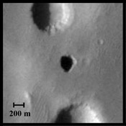
Subterranean Exploration
Caves and lava tubes provide a unique environment for preserving microbial life.
Orbiters have discovered pits on the surface of Mars that resemble caves or lava tubes.
By analogy with Earth, caves on Mars may contain signatures of past microbial life and become valuable resources for study.
Figure 1 - Possible cave on Mars, image captured by NASA’s Mars Odyssey Rover. Credit: NASA [1]
Notes:
This project focuses on subterranean exploration, specifically in caves and lava tubes. Caves and lava tubes are special environments because they often preserve microbial life. Orbiters around Mars have discovered pits on the surface that appear to be entrances to caves. So, caves on Mars present an amazing opportunity for research, primarily on the topic of potential remnants of microbial life.

Slide 3
Challenges
Cave environments are difficult to navigate autonomously.
Confined passageways
GPS-denied
Low light
Sharp corners blocking RF signals
Notes:
However, exploring caves on another planet is extremely difficult. This is because the exploration would ideally be fully autonomous, meaning we don’t need to wait for controls from someone on Earth, and the environments presents the challenges of confined passageways, no GPS for navigation, low light conditions, and sharp corners that block radio communication signals.

Slide 4
Project Goals
My Focus
Develop a concept for a system of autonomous aerial vehicles that can explore extraterrestrial cave environments, addressing the extreme environment and GPS-denied conditions.
Develop autonomous flight controls for the aerial vehicles. ✅
Develop a multi-vehicle communication system for the vehicles. ✅
Validate the vehicle's ability to navigate in a GPS-denied environment. ✅
Notes:
So, the goal of this project is to develop a concept for a system of autonomous aerial vehicles that can explore extraterrestrial cave environments, while addressing the accompanying challenges, including autonomous exploration and GPS-denied navigation.
I’m working on it alongside several other researchers, primarily Rebecca Schreiner, Stephen Ponder, Adrien Bouskela, and Dr. Sergey Shkarayev, and my focus on the project is developing autonomous flight controls for the aerial vehicles, developing a multi-vehicle communication system, and validating the vehicle’s ability to navigate in a GPS-denied environment.

Slide 5
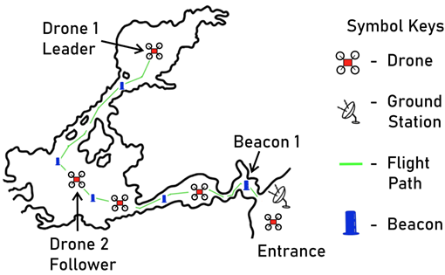
Concept of Operations
Small, lightweight quadcopter drones are deployed to explore the cave
The drones are organized into a train configuration
  A leader drone explores first
  A train of follower drones follow its footsteps
At each sharp corner, a telemetry repeater beacon is dropped
  Propagates RF signals around corners
Figure 2 - Train of drones (Ponder et al, 2022 ) [2].
Notes:
Getting right into it, here is our concept for the cave exploring vehicles. The general idea is that a train of drones is employed, with the drone at the front, the leader drone, bravely exploring ahead in unknown territory, and the other drones, follower drones, following its exact footsteps. This create a string of drones all following the leader.
In addition, at each sharp corner, a telemetry repeater beacon can be dropped. The telemetry repeater beacons ensure stable communications between drones and ground station at the entrance.

Slide 6
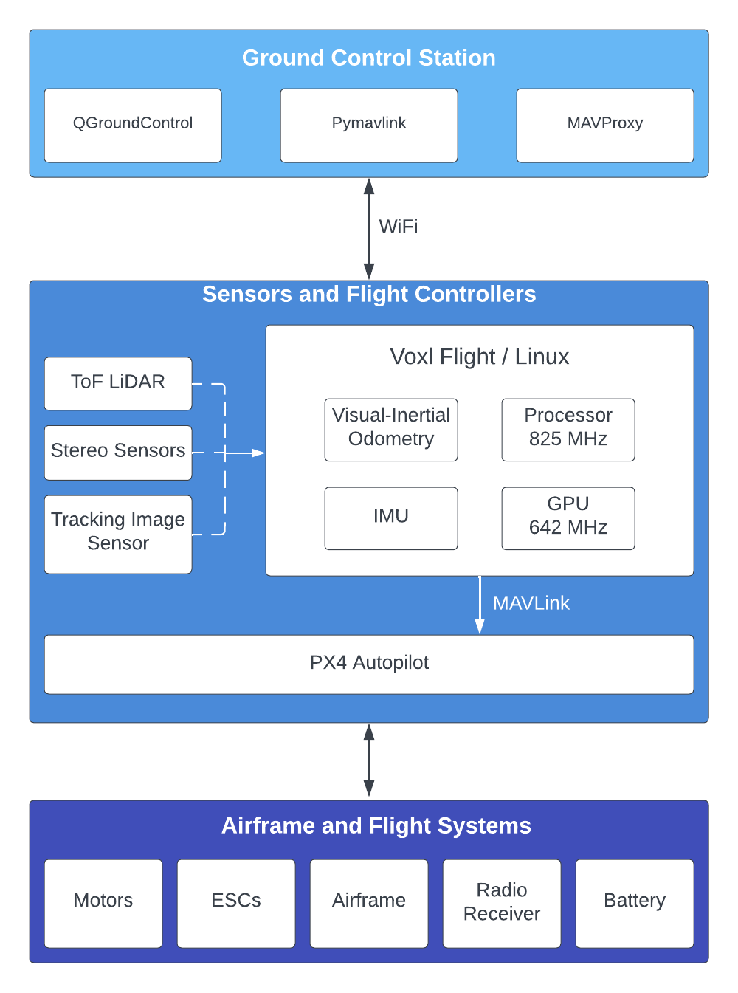
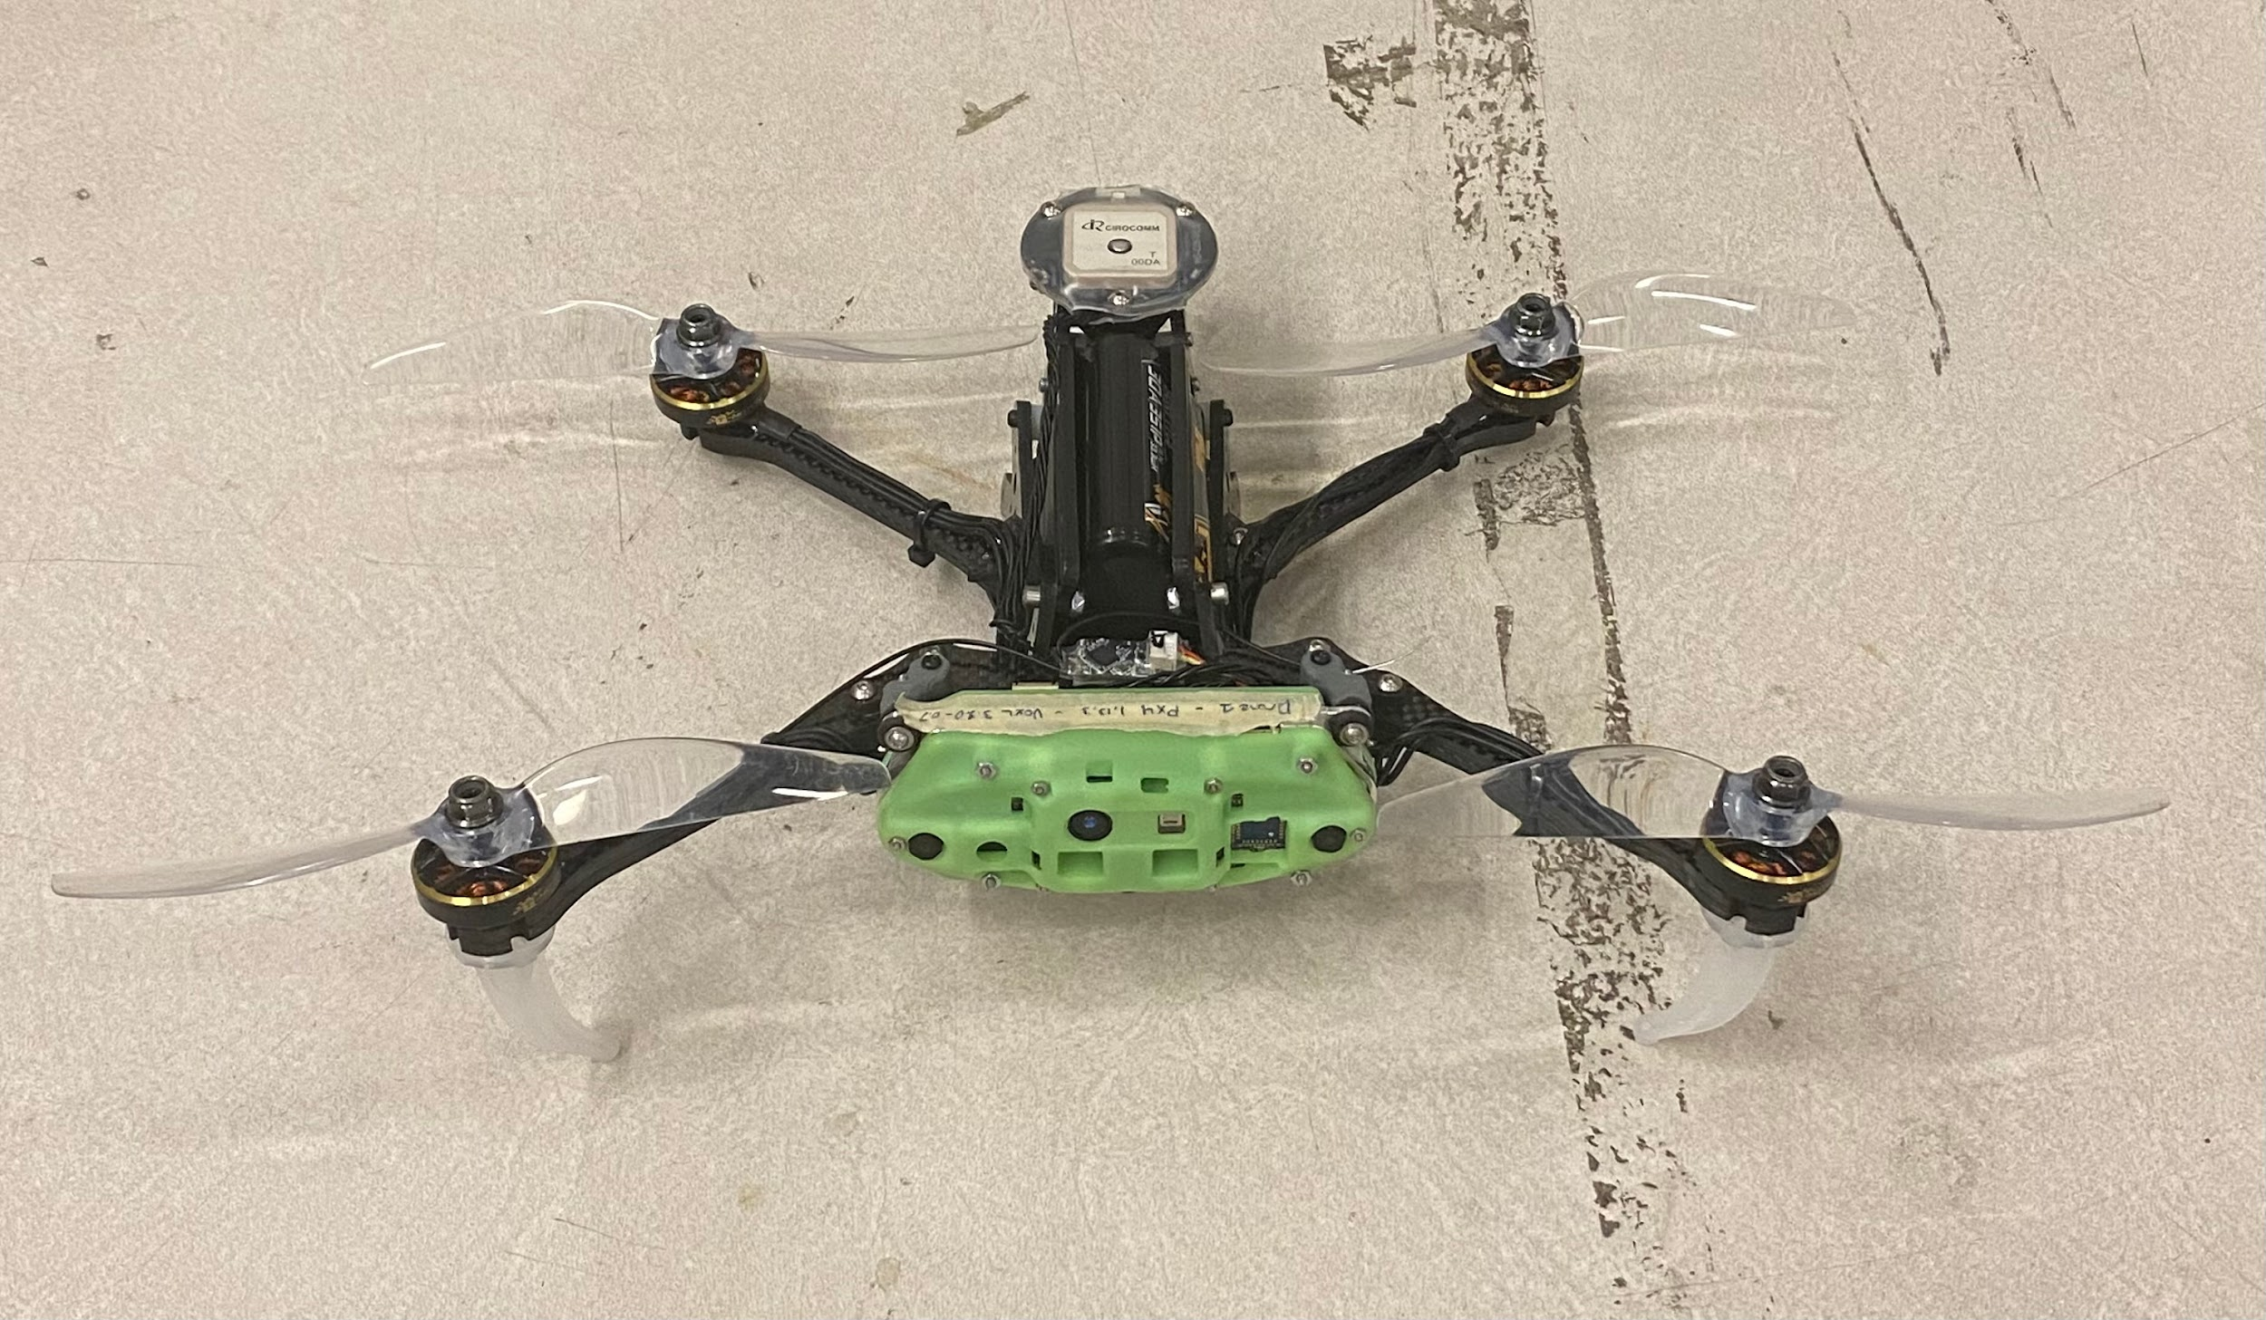
System Overview
Figure 3 - Test drone, ModalAI VOXL Seeker.
Notes:
Here is an overview of what each drone in the train looks like. Everything inside of the grey dashed line of the block diagram is physically part of the drone, and right above that dashed line is the ground station that connects to each drone. The important things to see here are that each drone includes a Time of Flight LiDAR sensor, stereo image sensors, and a tracking image sensor. These are used for navigation, as we will talk about later.
On the left, we can see an image of one of the drones used for testing inside of our laboratory. Below that is an image of the the ground station software that is monitoring the drone.

Slide 7
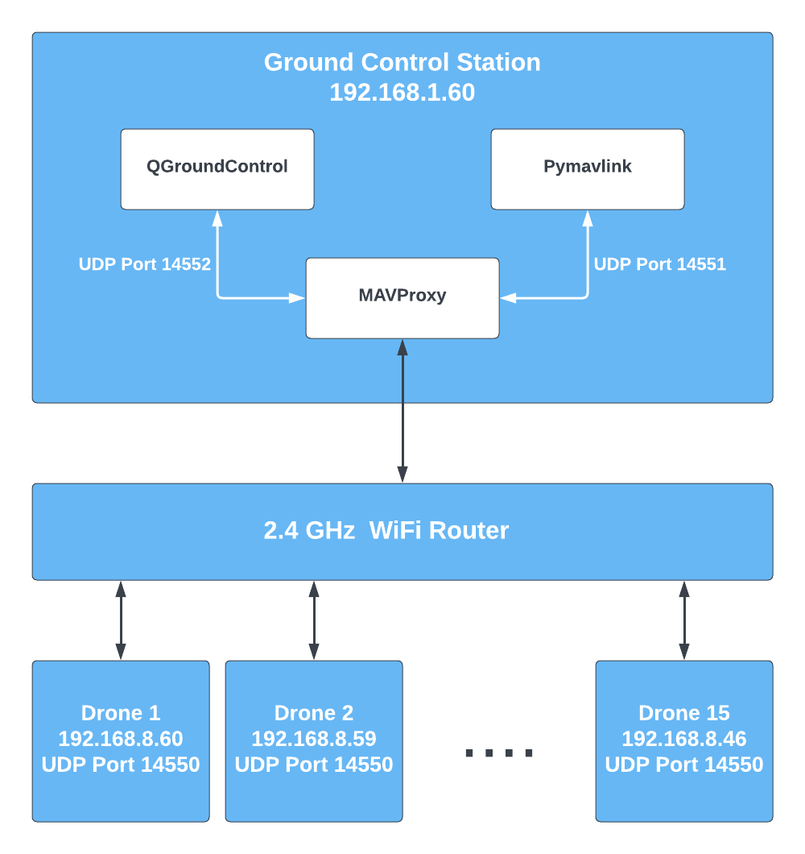
Software and Communication Architecture
Notes:
On the ground station side, we need a way to communicate with a lot of drones at once. This block diagram shows how the ground station is able to talk to and control all of the drones over WiFi. QGroundControl is the ground station software that monitors the flight, Pymavlink is a Python package that allows us to send custom commands to the drones, and MAVProxy forwards commands to the correct destination drone in the train. A WiFi router allows all of the drones in the train to connect to our ground station computer at the same time.

Slide 8
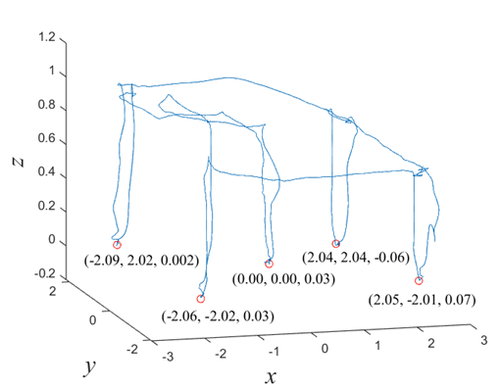
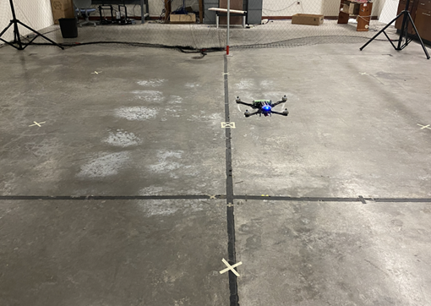
Localization
Notes:
Now, even more interesting than the block diagrams are the actual test flights that we completed with the initial drones. The drone fuses data from the stereo cameras and lidar that we talked about earlier, along with IMU data, with an extended Kalman filter. The result is that we are able to estimate the position of the drone in local coordinates. This means that we can track the drone’s displacement from its starting point in all three axis. Shown on the left is the drone in flight, and shown on the right is a re-creation of the flight path based on the drone’s recorded local position estimate. The drone landed on the ground at four corners spaced four meters apart each, and we can see on Figure 3 that the drone’s position estimate was only off by 9 centimeters, or 4.5%, in the worst case.

Slide 9
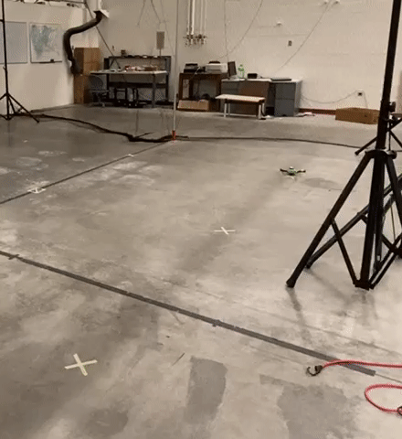
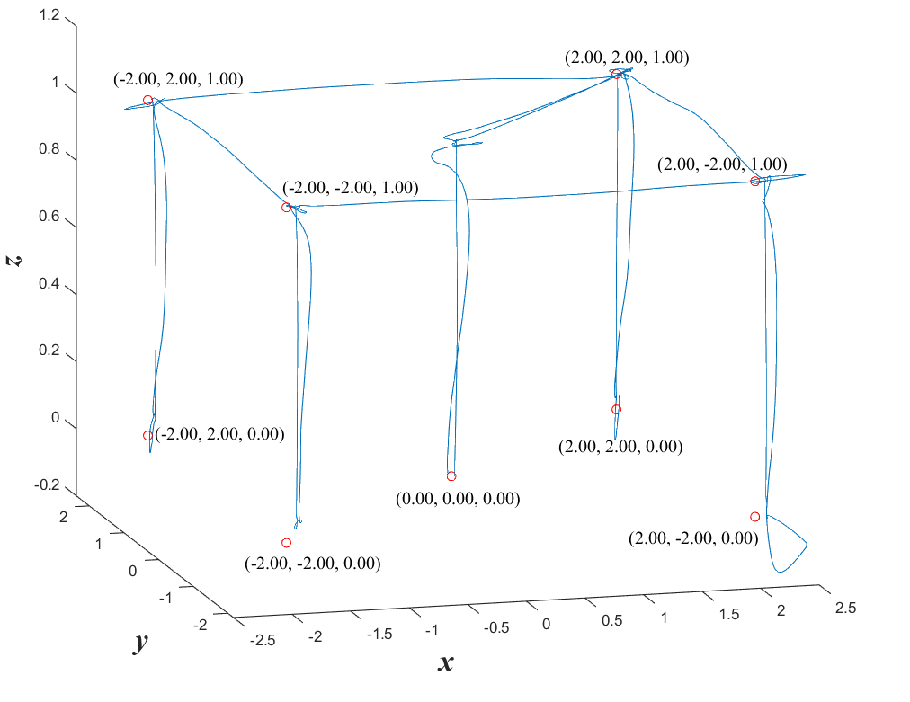
MAVLink-Based Flight Controls

Slide 10
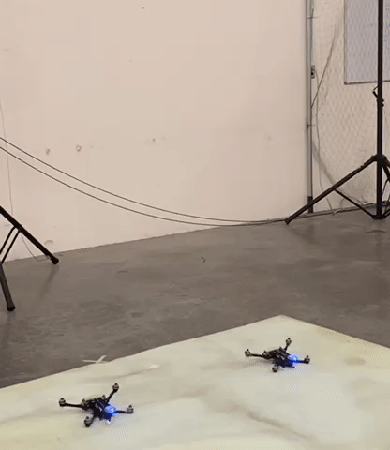
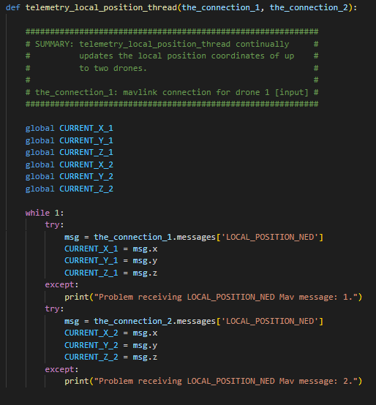
Multi-Drone Setup

Slide 11
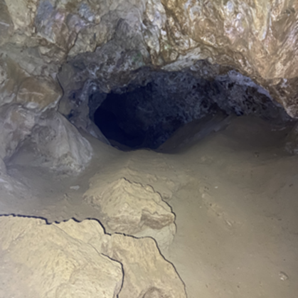
Next Steps
Testing in more extreme environments
  Low light levels
  Confined spaces
  Sharp corners
Develop leader-follower algorithm
  Create ‘train’ configuration
Collaboration with ECE department to create feature recognition algorithm
  Recognize cave entrances & exits
Figure 4 - Peppersauce Cave, AZ (Ponder et al, 2022) [2].

Slide 12
Acknowledgements
Thank you to:
Dr. Sergey Shkarayev
Adrien Bouskela
Michelle Coe
And The Arizona Space Grant Consortium!
Rebecca Schreiner
Stephen Ponder
Fellow Space Grant Interns

Slide 13
References
[1] Webster, G., & Brown, D. (2009, December 17). NASA orbiter finds possible cave skylights on Mars – NASA mars exploration. NASA, https://mars.nasa.gov/news/270/nasa-orbiter-finds-possible-cave-skylights-on-mars/
[2] Ponder, S. F., Schreiner, R. L., & Shkarayev, S. (2022). Development of Planetary Science and Technology for Caves and Lava Tubes Explorations Through Investigations of Analog Environments on Earth.

